Slide 1
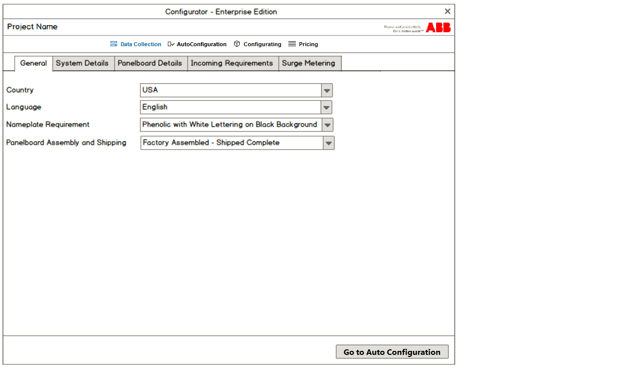
1237
42 (0,0) (abb logo182x28)
35 (0,40) (button images 150x35)
Tab images 148x35
576 (0,75)
708
57 (0,651)

Slide 2
1237
made in GIMP, Arial 12
708
made in GIMP
Arial 13 Bold
164
18
1050

Slide 3
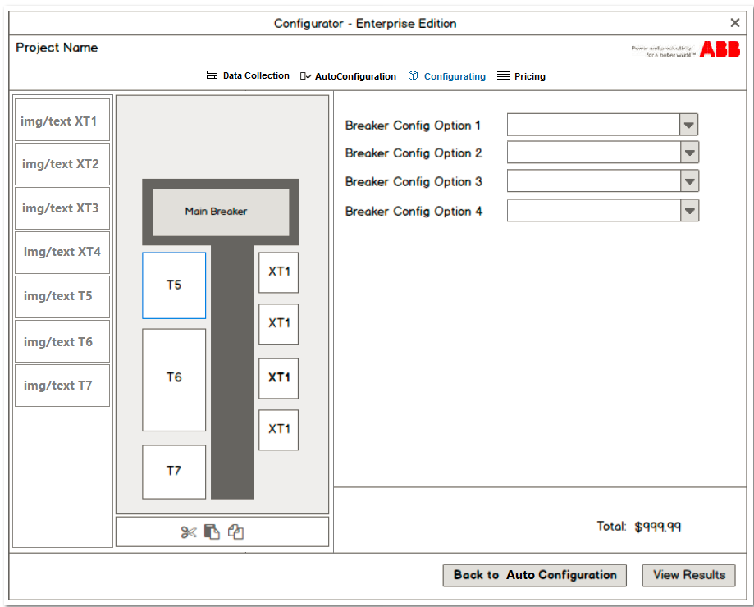
546
30
486 (199,75)
200 (0,75)
485 (200,75)
552 (685,75)

